Slide 1
C Programming
Lecture 13

Slide 2
Selection statement
Allow us to execute parts of code with specified preconditions.
Two basic types
  if statements
  switch statements

Slide 3
if statement
if ( expression ) {
statement …
}
expression specifies condition under which statement should be executed
statement is executed if expression is not 0
Brackets around the expression are mandatory.
if ( expression ) {
statement …
} else {
statement …
}

Slide 4
if statement
if ( expression ) {
statement…
} else if ( expression ) {
statement…
} else {
statement…
}
Example
if ( x > 0 )
printf(“%d is a positive number\n”, x);

Slide 5
Conditional expression
General form
  condition ? expr1 : expr2
Where
  ? is a ternary C operator
condition denotes the test to make (e.g. ( x > 0 ) but any other expression can be used).
expr1 denotes the resulting value if test true.
expr2 denotes the resulting value if test false.

Slide 6
ternary operator example
if (a > b) {
result = a;
} else {
result = b;
}
Can be rewritten as the following:
result = a > b ? a : b;

Slide 7
switch statement
switch( expression )
{
case constant-expression:
statement;
break;
case constant-expression:
statement;
break;
default:
statement;
break;
}

Slide 8
switch
expression must have int value (chars may be used but will be treated as integers).
constant-expression must be constant integer.
default case (denoted by “default:”) may be omitted.
What does it mean?
We first evaluate expression.
Then, we try to find the first matching case
  And we execute all statements starting from here.
  Unless we hit “break” statement, which makes us exit switch.
Default case always satisfied (if nothing else, do this).

Slide 9
for statement
for loop
for(expression1; expression2; expression3 ){
statement…
}
First, execute expression1.
expression2 is the terminate test (condition);
expression3 is the modifier;

Slide 10
Example
for ( int x = 0; x < 3; x++ )
{
printf( "x = %d \n", x );
}
  First time: x = 0;
  Second time: x = 1;
  Third time: x = 2;
  Fourth time: x = 3; (don’t execute the body)

Slide 11
while loop
while ( expression ) {
statement …
}
Checks value of the expression
If expression is true, it executes the statements and repeats the whole process again.
If expression is false, it terminates.
An example
int x = 3;
while ( x > 0 ) {
printf( "x = %d \n", x );
x--;
}

Slide 12
1D arrays
Allows us to represent a number of values of the same type.
  The values are called elements.
  The values are referred by their position.
Basic form
  type name[length];
    type: Specifies type of the array elements.
    name: Specifies name of the array.
    length: Specifies the total number of elements.
Example
  Declare array named “a” of 10 integers
    int a[10];

Slide 13
Accessing Elements of 1D Arrays
Elements referred to by position
  First position is 0
  Last position is (length-1)
  Element in position i is referred to as name[i]
Example
int a[10]
a[0] | a[1] | a[2] | a[3] | a[4] | a[5] | a[6] | a[7] | a[8] | a[9]
9 | 7 | 5 | 4 | 2 | 3 | 0 | 12 | 19 | 8

Slide 14
Strings
Strings are defined as arrays of characters.
  The only difference from a character array is, a symbol “\0” is used to indicate the end of a string.
For example, suppose we have a character array,
char name[8], and we store into it a string “John”.
The length of this string is 4, but it has 5 elements.
J | o | h | n | \0

Slide 15
Functions
Functions are easy to use; they allow complicated programs to be broken into small blocks, each of which is easier to write, read, and maintain. This is called modulation.
Basic form of function:
return-type function-name(parameters…)
{
declarations
statements
return result
}
function body

Slide 16
Parameters and return values
Calling function
  function-name( parameters )
Parameters
  Parameters can be variables of any type.
  Parameter declarations separated by “,”
  For no parameters, leave empty.
  Examples
    float average( float x, float y )
Return values
  Return value can be one value of some type.
  We cannot return arrays but other than that anything.

Slide 17
Function prototyping
Before you use a function C must have knowledge about the type it returns and the parameter types the function expects.
If a functions has been defined before it is used (called) then you are ok to merely use the function.
If NOT then you must declare the function.
  int volume( int, int, int );
It is good practice to prototype all functions at the start of the program.

Slide 18
average function
#include <stdio.h>
float average( float a, float b ){
return ( a + b ) / 2;
}
void main(){
float x, y, avg;
printf(“Input 2 floating-point numbers: ");
scanf( "%f%f",&x,&y );
avg = average( x, y );
printf( "The average is: %f\n", avg );
}

Slide 19
Pointers
What is pointer?
  A pointer is a variable which contains the address in memory of another variable. We can have a pointer to any variable type.
Declaring a pointer variable
  int * ptr;
  char *name;
How to obtain the address of a variable?
  int x = 9;
  ptr = &x;
  where unary operator & gives the “address of a variable”.
  Dereference operator * gives the “content of a pointer”
How to get the value of the variable indicated by the pointer?
  int y = *ptr;

Slide 20
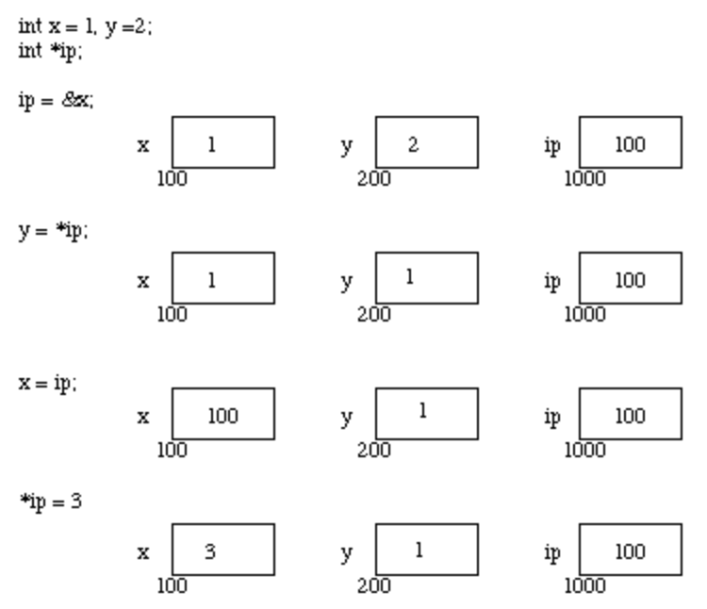
Pointer, Variables and Memory
Supposed x resides at memory location 100, y at 200 and ip at 1000.
  A pointer is a variable and thus its value need to be stored somewhere.

Slide 21
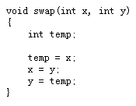
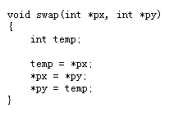
swap the value of two variables
When C passes arguments to functions it passes them by value.
We may want to alter a passed argument in the function and receive the new value back.

Slide 22
Why is the left one not working?
swap
x, y
x, y, a, b
are all local variables
main
a, b
call swap(a, b) in main

Slide 23
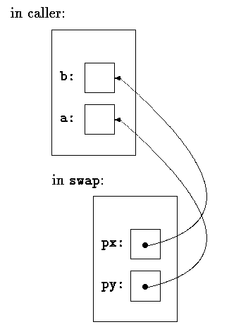
Why is the right one working?

Slide 24
Command-Line Arguments in C
main function does not have to include any input arguments.
int main()
{
…
}
However, main function can also include two arguments, which specify command-line arguments.
int main( int argc, char **argv )
{
…
}

Slide 25
Command-Line Arguments
In C you can pass arguments to main() function.
int main( int argc, char *argv[] )
  char *argv[] ~ char **argv
argc - The number of command-line arguments, including the command name
argv[n] - A pointer to the nth command-line argument as a character string
How to pass your own arguments?
./hello 10

Slide 26
Command-Line Arguments
cmd arg1 arg2
The first command-line argument is always the name of the executed file.
The remaining arguments are user-specified arguments.
argc is 3
argv[0] points to the command name cmd
argv[1] points to the string arg1
argv[2] points to the string arg2
argv[3] is 0 (NULL)

Slide 27
Print out string length
#include <stdio.h>
#include <string.h>
int main( int argc, char **argv )
{
int i;
for( i = 0; i < argc; i++ )
printf("argv[%u]=\"%s\" (lenth=%d)\n", i,
argv[i],(int)strlen(argv[i]));
return 0;
}

Slide 28
/* the echo command */
#include <stdlib.h>
#include <stdio.h>
int main( int argc, char *argv[] )
{
int i = 1;
while ( i < argc ){
printf("%s", argv[i++]);
printf(" ");
}
printf("\n");
return EXIT_SUCCESS;
}

Slide 29
GCC Compilation Phases
Preprocessing
Compilation
Optimization
(optional)
Executable File
Assembly
Linking/Loading

Slide 30
Compilation phases
Preprocessing—The first phase is performed by the cpp (C preprocessor) program (or gcc -E). It handles constant definition, macro expansion, file inclusion, conditionals, and other preprocessor directives.
Compilation—Taking the output of the previous phase as input, the compilation phase performs syntax checking, parsing, and assembly code (.s file) generation.
Optimization—This optional phase specializes the code to the computer’s hardware architecture and improves the efficiency of the generated code for speed and compactness.

Slide 31
Compilation phases
Assembly–takes .s files and creates object (.o) files containing binary code and relocation information to be used by the linker/loader.
Linking—The collect2/ld program is the linker/loader which combines all object files and links in necessary library subroutines as well as run-time support routines to produce an executable program (a.out).

Slide 32
The C Preprocessor
Set of actions performed just before the compilation of a source file
Inclusion of other files, definition of symbolic constants and macros, conditional compilation of program code, and conditional execution of preprocessor directives
The preprocessor provides important facilities that are especially important for writing system programs.
Also known as directives. Directives to the C preprocessor begin with the character # in column one. #include
  include other files into a source file before actual compilation begins.

Slide 33
Preprocessing
Cause the programs to be modified before compilation
Before preprocessor application
#define LEN 100
int main()
{
printf ( "%d\n", LEN * LEN );
}
After preprocessor application
int main()
{
printf ( "%d\n", 100 * 100 );
}

Slide 34
Independent compilation
Preprocessor runs before compilation, or as first pass of compilation
  Preprocessor removes the comments from the source even before executing compiler directives
  Large programs are difficult to maintain
  Problem solved by breaking the program into separate files
  Different functions placed in different files
  The main function appears in only one file, conventionally known as main.c

Slide 35
Independent compilation
Advantages
  Reduction in complexity of organizing the program
  Reduction in time required for compilation
    Each file is compiled separately
    Only those files are recompiled that have been modified
    Compiler creates object files corresponding to each source file
    The object files are linked together to create the final executable
    Compilation time is reduced because linking is much faster than compilation

Slide 36
Independent compilation
Source files are compiled separately under Linux using the -c option to the compiler
$ gcc -c main.c
  The entire sequence of commands to create an executable can be specified as
  gcc -c main.c
  gcc -c func.c
  gcc -o prog main.o func.o

Slide 37
Including files
The directive
  #include "filename"
  instructs cpp to include the entire contents of filename (note that the " marks are part of the command).
If the filename is not given as a full pathname, then it is first sought in the directory where the source code containing the #include statement is located; if it is not found there, then some standard system directories are searched.
If you have header files in non-standard places, use the –I option to add extra header search directories.

Slide 38
# include
The directive used to include the contents of a file
Written in either of the two following forms:
  #include <filename.h>
  #include "filename.h"
finds the file only in standard system directories such as /usr/include
"filename" directs the compiler to search in the current directory and if it is not found there, to look into the standard directories
#include files often contain function prototypes, #defines, and macros
Useful for storing constants and data structures when a program spans several files

Slide 39
Header files
Used to keep information common to multiple source files
A process to avoid duplication and allows for easier modification since a constant or type declaration need only be changed in one place
Files need the same #define declarations and the same type declarations (struct and typedef)
More convenient to declare these declarations in a single header file

Slide 40
Guidelines for a good header file
Header files should contain only
  Constant definitions
  Type declarations
  Macro definitions
  Extern declarations
  Function prototypes
  Header files should not contain
  Any executable code
    No function definitions
  Definition of variables
    Only exception is to declare variables
    Every variable declaration should be an extern declaration
    Inclusion of variable definitions in header file causes multiple definitions of the same symbol which is a linkage error

Slide 41
#define preprocessor directive for constants
Used to create symbolic constants with the format
#define identifier token . . .
#define TRUE 1
#define PI 3.14159265358
If no tokens are given, identifier is defined to be 1.
The preprocessor will replace the identifier with the given tokens in the source code.
Be careful not to put a semicolon at the end of the statement

Slide 42
Macros
A macro is an operation defined in a #define preprocessor directive with or without parameters
A macro without parameters is processed just like a symbolic constant
#define macro-name (arg1, arg2, ...) token ...
#define MIN(x,y)( (x) > (y) ? (y) : (x) )
a = 1 + MIN( b = c + 2, d );
A \ can be used to extend the #define to the next line so that the definition can be arbitrarily long
Removing a defined macro:
  #undef macro-name

Slide 43
Example
int N = 100; /* external variable */
main(){
printf ( "%d\n", N ); /* 100 */
#define N 123
printf ( "%d\n", N ); /* 123 */
f();
}
int f ( void ){
printf ( "%d\n", N ); /* 123 */
#undef N
printf ( "%d\n", N ); /* 100 */
}
Notes:
Macros may be used to replace a function call with inline code prior to execution time, eliminating the overhead of a function call

Slide 44
Conditional Inclusion
Section of code can be included in or excluded from the compiling process, depending on certain conditions that the preprocessor can check.
General form
#if constant-expression
source code lines A
[#else
source code lines B] //optional
#endif

Slide 45
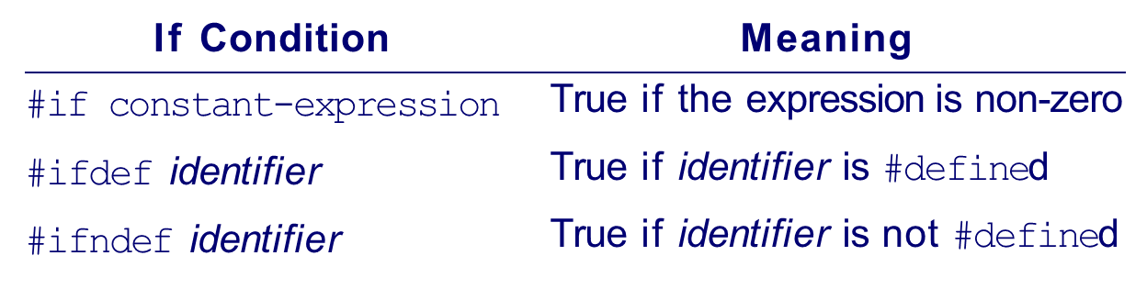
Conditional inclusion
const-expression must not contain variables or function calls
If constant-expression evaluates to non-zero, the first part of the program is compiled
#else part is optional
Possible condition are listed below:

Slide 46
Conditional compilation
Used here for declaring an identifier DEBUG to assist in debugging
  Leave the debugging statements in the source code but do not compile them in the product
#define DEBUG
#ifdef DEBUG
printf("Variable values for debugging\n");
#endif DEBUG

Slide 47
Example
/******************************************************************************/
/* File a.h */
#define N 1000
/******************************************************************************/
/* File a.c */
#include "a.h"
int main()
{
#ifndef N
printf ( "#define-line for N missing in file a.h\n" );
exit(1);
#else
#if N > 100
printf ( "Matrix needs too much memory: N too large\n" );
exit ( 1 );
#else
float matrix[N][N];
... /* rest of program */
#endif
#endif
}
/******************************************************************************/

Slide 48
Preventing multiple loading of header files
In large C programs, it is common practice to have many source code and header files.
  The header files often have #include lines to include other headers.
  To avoid possible multiple inclusion, a header file can be written as a big conditional inclusion construct.
/* A once only header file xyz.h */
#ifndef _ _xyz_SEEN_ _
#define _ _xyz_SEEN_ _
/* the entire header file*/
.
.
.
#endif /* _ _xyz_SEEN_ _ */
Notes:
xyz_SEEN becomes defined once the file xyz.h is read by cpp. This fact prevents it from being read again due to the #ifndef mechanism

Slide 49
Compilation Stages
Preprocessing
Compiling—The compiling phase takes the output of the preprocessing phase and performs parsing and code generation. If a -O option is given, then the code generation invokes code optimization routines to improve the efficiency of the generated code. The output of the compilation phase is assembly code.
Assembly—Assembly code is processed by the assembler as to produce relocatable object code (.o).
Linking and Loading—Linking/loading produces an executable program (the a.out file) by combining user-supplied object files with system-supplied object modules contained in libraries as well as initialization code needed.

Slide 50
The C Library
The C library provides useful functions for many common tasks such as I/O and string handling.
A set of POSIX-compliant libraries are available.
Library functions depend on system calls to obtain operating system kernel services.

Slide 51
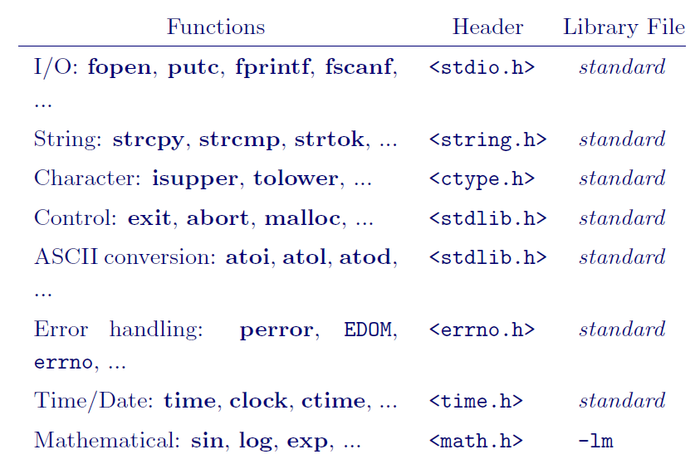
Common C Lib Func.

Slide 52
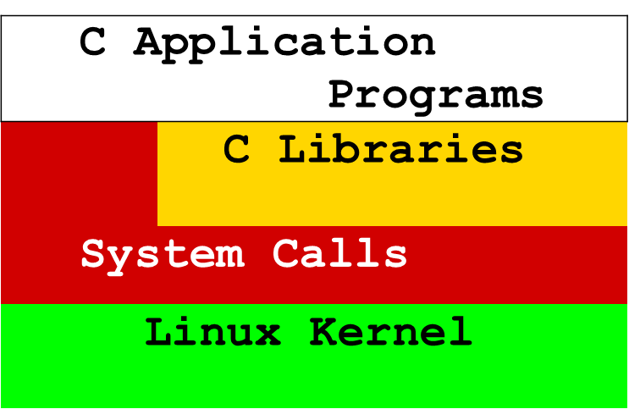
Library and System calls
Below shows the relation among the Linux kernel, system calls, library calls, and application programs in C
By using standard library calls as much as possible, a C application can achieve more system independence.

